Slide 1
Predictive Modeling
27 OCTOber, 2021

Slide 2
Answering Q3
What attributes of external support (externally provide training, coaching, DESE support) influence the rate of improving instruction? What are the conditions that cause the contribution of these variables to vary?
“Improving instruction”: increase in ETLP domain on CWIS
Possible influencing variables
Q3 part (Training format: virtual learning platform or trainer or both)
Datasets: CWIS & Coaching Logs
Possible Question:
Does the consistency of coaching influence the rate of improving instruction?

Slide 3
Target Data Table
Aggregate CWIS, Coaching --> 1 district format
Aggregate <- DT[ , (), by = (State.District.ID, period)]
State District ID | Period | Consistency Measure
MO-002097 | Aug2018-Feb2019
MO-002097 | Aug2019-Feb2020
MO-004110 | Aug2020-Feb2021
… | …
Each rows ---> different districts in different years

Slide 4
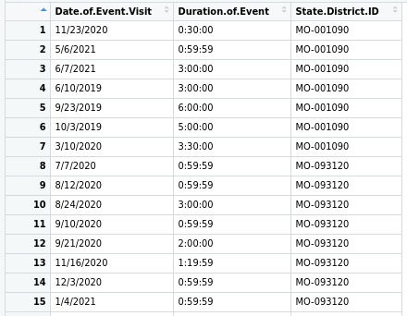
Coaching Data
Relevant Columns = 3
Total observations = 5,924
Columns = 3

Slide 5
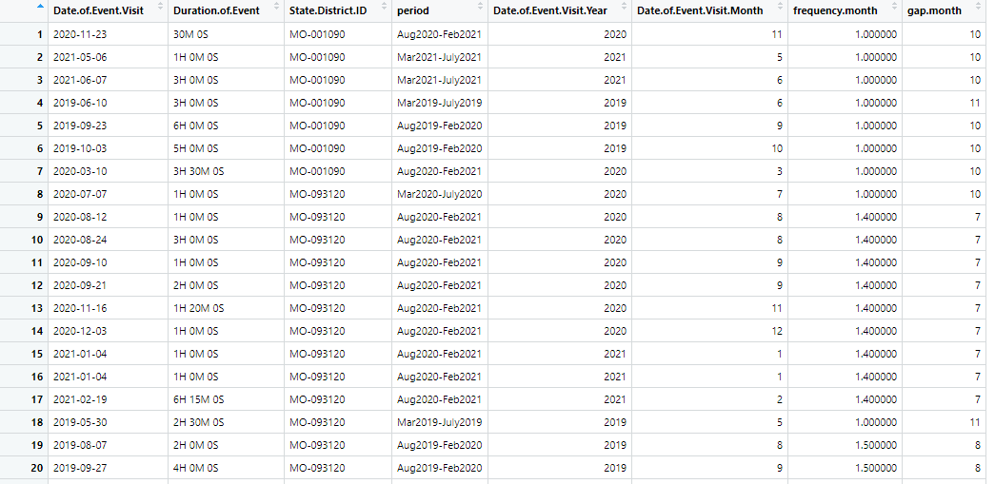
Coaching Data
Time Period
If (Month < 3) ->Time Period=("Aug", Year-1 , "-" , "Feb", Year)
If (Month > 3 & Month < 8) ->Time Period =("Mar", Year , "-" , "July" , Year)
else ->Time Period =("Aug", Year , "-" , "Feb" , Year+1)
Duration of Event
Remove travel time
Convert to time_periods

Slide 6
Coaching Data
Frequency.Month
months.count <- c(0, 0, 0, 0, 0, 0, 0, 0, 0, 0, 0, 0)
months.count[row$Date.of.Event.Visit.Month] <
months.count[row$Date.of.Event.Visit.Month] + 1
for(i in months.count) { if( i > 0) {
total.active.months <- total.active.months + 1 }
Frequency <- sum of coaching / total.active.months
Month gap
gap <- 12 - total.active.months

Slide 7
Aggregate Coaching Data How?
Taking Mean
aggregated.district.periodwise.data <- aggregate(.~State.District.ID+period, required.timeframe.cols, mean)
Taking Sum
aggregated.district.periodwise.data <- aggregate(.~State.District.ID+period, required.timeframe.cols, sum)
Total Districts = 775
Columns = 5

Slide 8
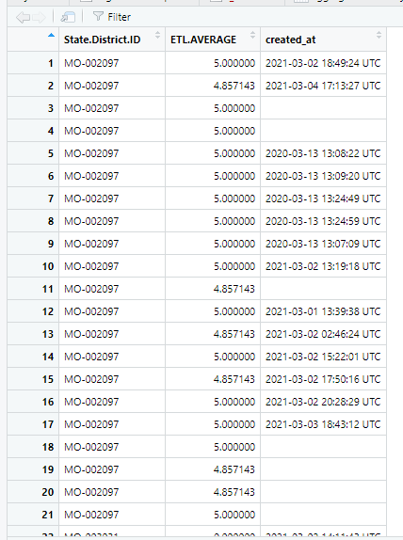
CWIS Data
Relevant Columns = 3
Total observations = 25,999
Columns = 3

Slide 9
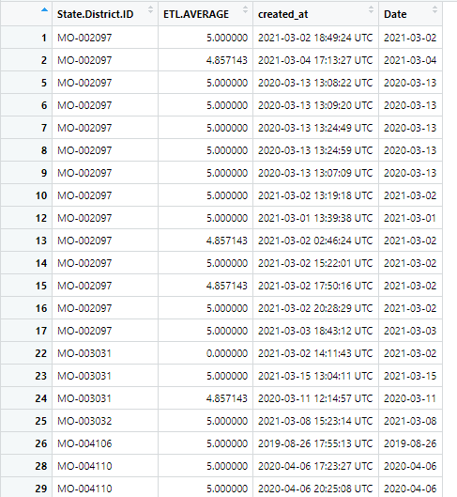
CWIS Data
Date extraction from created_by columns

Slide 10
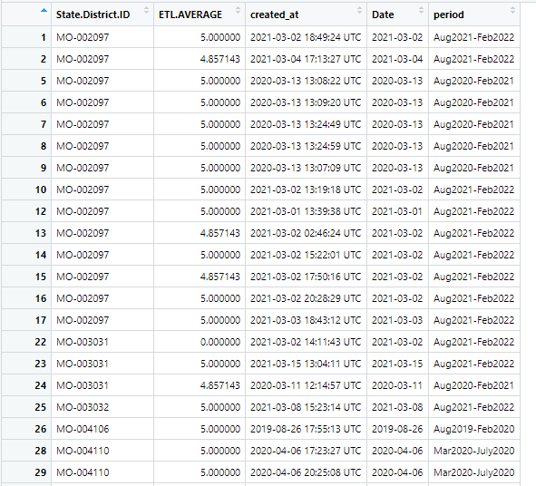
CWIS Data
Time period calculation

Slide 11
Aggregate CWIS How?
Operation = MEAN between the survey values of different schools in same district
SUM between the survey values of different schools in same district
cwis.aggregated.district.period <- aggregate(.~State.District.ID+period, cwis.cols, mean)
Total Districts = 426
Columns = 3

Slide 12
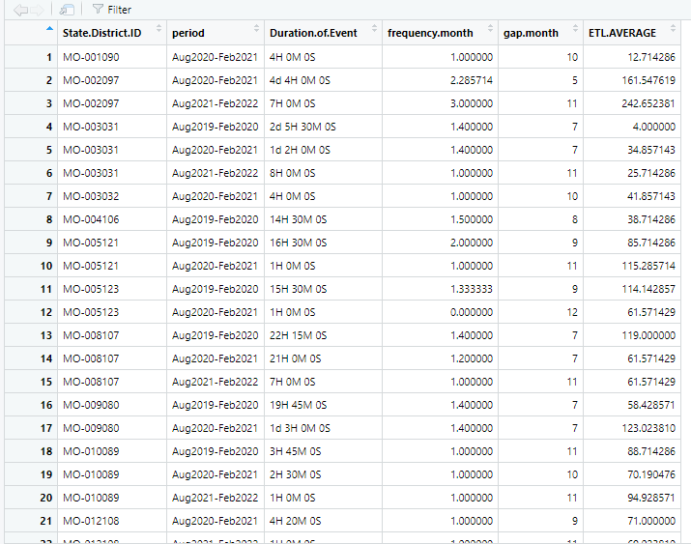
Aggregate(CWIS, Coaching Logs)
cwis.logs.aggregate <-
merge(aggregated.district.yearwise.data,
cwis.aggregated.district.period,
by=c("State.District.ID", "period"))

Slide 13
Aggregate(CWIS, Coaching Logs)
Rows = 306, Columns = 6
Unique districts+period are taken
Each row represents cwis survey per district and coaching level data
Some districts had cwis survey data but no coaching logs data

Slide 14
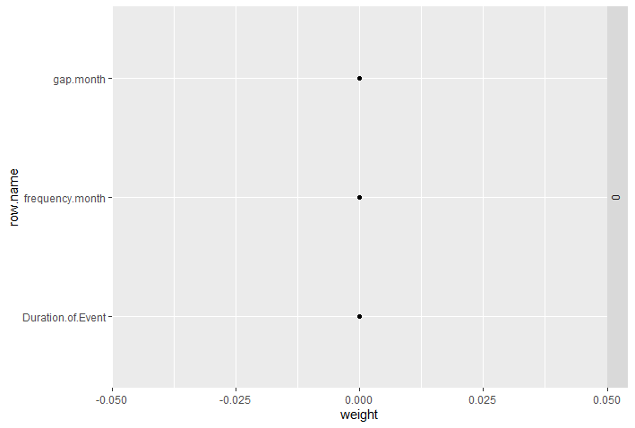
Cvglmnet Model

Slide 15
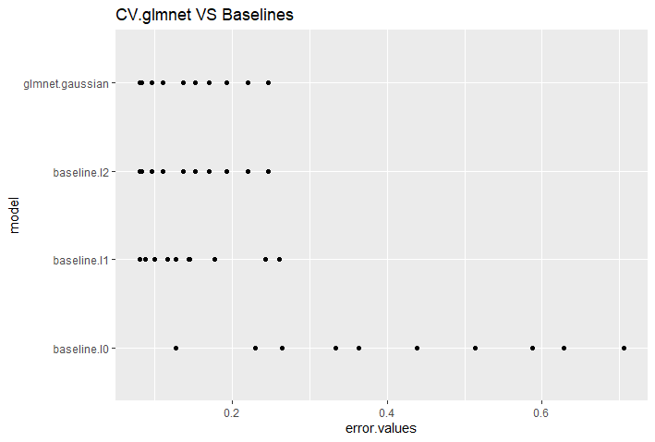
Comparison of Cvglmnet with Baselines

Slide 16
Questions
Should we aggregate the data based on academic year eg. August-March 2019-2020?

Slide 17
Baseline/Featureless Models
Simple Models that provide reasonable results with arithmatic functions
Baseline predictions -> independent of inputs
Why use Baselines?
If baseline models perform better than our models -> the inputs have no relation with the outputs
Baselines Used:
L1 -> Regression Baseline -> Median
L2 -> Regression Baseline -> Mean

Slide 18
OrdinalNet
In statistics, ordinal regression is one kind of regresion analysis ued for predicting ordinal variables with ordered categories
It can be considered an intermediate problem between regression and classification.

Slide 19
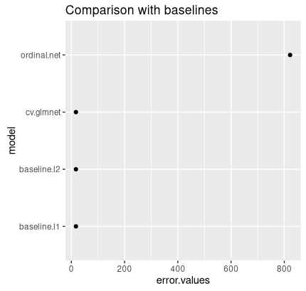
Comparison of models

Slide 20
Future works
Merge the three datasets for the training format question
Apply models with the dataset

